Slide 1

Cytopreparation
MS in Diagnostic Cytopathology Program
Division of Clinical Laboratory Sciences
Department of Clinical Lab and Medical Imaging Sciences

Slide 2
Learning Objectives
Explain the clinical importance of cytopreparatory techniques in Anatomic Pathology practice.
Compare and contrast cytopreparation methods and evaluate their suitability for various specimen types.
Analyze the effects of different cytology fixatives on cellular morphology and staining outcomes.
Discuss preprocessing principles (collection, transport, fixation) to ensure optimal cytologic sample quality.
Describe and demonstrate proper centrifugation.
Evaluate processing workflows to select the most appropriate preparation method for a given specimen.
Interpret technical and chemical parameters (e.g., fixative formulations) used in the processing of cytologic specimens.

Slide 3
What is cytopreparation?
Defined as the science of optimizing and standardizing the collection, preparation, and analysis of cytologic samples in ways that promote the detection of cells-of-interest and accurate interpretation of nuclear morphology.
Based on one overarching principle: “When we make a microscopical preparation for cytopathology, we should try to understand what we are doing and why.”
  We must understand the factors that went into collecting and preparing a specimen to achieve the best possible morphologic presentation.

Slide 4
Principles of Cytopreparation
Underlying principles of cytopreparation that support the overarching principle include:
  Fresh specimens facilitate specimen processing and cell flattening
  Make preparations that are representative of the sample
  Flatten cells to enhance chromatin display
  Fix preparations immediately to maintain morphology
  Stain preparations to facilitate cell visibility, detection, and interpretation
  Mount preparations to optimize microscope objective’s performance
  Examine with a clean microscope and Köhler illumination to promote highest resolution
  Screen preparations in ways that facilitate abnormal cell detection

Slide 5
Improving Diagnostic Accuracy with Cytopreparation
Accurate cytodiagnosis based on adequate sampling, proper evaluation of the sample, proper fixation, preparation and staining of the cells.
Optimal cytologic presentation is directly related to the quality of the specimen, the fixative chosen to preserve the cellular details, and the stain used to render cells viewable.

Slide 6
Improving Diagnostic Accuracy with Cytopreparation
Results will not be optimal if:
  Specimen is: too bloody, too thick, or is left too long before processing in the laboratory, not fixed properly (fixative is not correct or the fixative is not applied quickly)
  Chemicals in the stain are old, not properly prepared, or not optimized for time.
Processes used in cytopreparation should be continually evaluated
Cytopreparation doesn’t end with a prepared sample.
  Must also consider how to best preserve residual cellular sample for use in special studies.

Slide 7
The Cytopreparatory Process: Preprocessing
Preprocessing Steps:
  Physician requests procedures for cytologic evaluation
  Physician collects sample or sends to specialist for collection (ex: a primary physician may request a fine needle aspiration of the Thyroid and send the patient to an ENT, radiologist, or interventional radiologist)
  Cytology requisition filled out at collection to accompany all cytologic specimens.

Slide 8
The Cytopreparatory Process: Preprocessing
Cytology requisition must include:
  Patient name/identifier (medical record number and birthdate)
  Requesting physician’s name and address
  Date of specimen collection
  Specimen source
  Pertinent clinical information: e.g. if Pap test ordered, we need patient’s age, date of last menstruation, any prior abnormal Pap findings

Slide 9
The Cytopreparatory Process: Processing
Step 1
Specimen transported to lab
Step 2
Specimen received and accessioned
Step 3
Specimen processed
Step 4
Specimen stained
Step 5
Specimen coverslipped
Step 6
Specimen is labelled
Cytopreparation typically performed by a “cytoprep technician” and supervised by cytologists
Evolution of cytoprep methods with new technologies (automation) and special studies (molecular studies, etc.)
No true standardization to cytopreparation and methods of preparation often vary from one laboratory to the next

Slide 10
Methods of Collection
Various methods of collection are used and depend on the specimen source: brushings, scrapings, fine needle aspirations, etc.
Regulations require collection method on the requisition form
Quality of collection greatly impacts preparation and interpretation of sample

Slide 11
Fixation and Cytology Fixatives
Processor must be knowledgeable of cytology fixatives and fixation including effects of solutions and processes on tissues and cells
Immediate and proper fixation of cells is essential to accurate cytologic interpretation (poor preparation can challenge even the best morphologist)
A fixative is an agent that maintains (as closely as possible) the cytomorphologic characteristics and diagnostically essential cytochemical elements of the cell.

Slide 12
Fixation and Cytology Fixatives
Appropriate fixatives for cytodiagnostic purposes should be able to:
  Penetrate cells rapidly
  Minimize cell shrinkage,
  Maintain morphologic integrity
  Deactivate autolytic enzymes
  Replace cellular water
  Facilitate diffusion of dyes across cell boundaries
  Help cells adhere to a glass surface
  Provide consistent results over time
  Produce a permanent cell record
  Stop cellular and microbial growth (antimicrobial).

Slide 13
Types of Cytology Fixatives
Wet fixatives
Coating Fixatives
Mucoid Fixatives
Air drying
Lysing Fixatives
Fixatives for Cell Block Preparation
Fixatives for ancillary techniques

Slide 14
Fixation and Cytology Fixatives
Main fixative for cytologic preparations: alcohol
  Dehydrating agent that causes cell shrinkage due to its replacement of water, a major component of protein structure.
Cellular structures become coarser, nuclear detail is sharpened and nuclear chromatinic patterns are produced.
Fixation with alcohol is the first step in processing in the Papanicolaou staining procedure

Slide 15
Body Fluids
Fresh samples like CSF, body cavity fluids, & urines must be preserved before processing to maintain morphology.
“Prefixation” - specimen is collected in a medium to preserve morphology.
  not needed if samples go immediately to the lab (24 hours or less)
Cellular damage can occur between collection and preparation (even within 24 hours) and depends on: pH, protein content, enzymes, bacterial content

Slide 16
Body Fluids
Fresh fluids preferred for various reasons:
  Body fluids act as a tissue culture medium when below body temperature
  Contain soluble proteins that ease through membrane filters
  Alcohol causes protein precipitate that can clog filters, prevents adherence to slides (pretreat with albumin), retains stains, and causes poor visibility
  Potential interference with special stains and ancillary techniques

Slide 17
Body Fluids
Refrigeration preferred to prefixation
  Refrigeration slows bacterial growth
  High mucus content samples (e.g. sputum and bronchial aspirates) can be preserved 12-24 hours when refrigerated.
  High protein content specimens (e.g. pleural and peritoneal fluids) can be preserved 24-48 hours.
  Low mucus or protein specimens (e.g. CSF and urine) can be preserved only 1-2 hours due to rapid degeneration caused by enzymes.
    Specimen should be brought to lab immediately or prefixed.
  Low pH specimens (e.g. gastric samples) can be collected on ice and should be prepared immediately.

Slide 18
Body Fluid Prefixatives
Ethanol: do not use for body cavity fluids (peritoneal, pleural, pericardial)
  50% for all body sites except GI.
  75% for bronchial samples
  95% for GI, bronchial, and saline washing collections
Saccomanno’s fixative: ethanol and polyglycol (carbowax) - Add equal volume.
  All body sites except GI
Mucolexx® by Shandon. - Add equal volume.
  For mucoid and fluid samples.
Liquid Based Preparations (Hologic’s Cytolyt®, BD TriPath Imaging PreservCyt™ and CytoRich™ Solutions)
Prefixatives & liquid based prep fixatives contain mucolytic agents (Saccomanno) and hemolytic agents (Carnoy’s fixative).

Slide 19
Body Fluid Prefixatives
Cell Blocks - preparation of histologic material from cytologic sample
  Ideal for architectural information, can be used for special stains and molecular techniques
  Alcohol hardens and is NOT used for tissue preservation
  Fixatives with high water content are ideal for tissue
  Formalin or formol are ideal. 10% formalin. Solution of formaldehyde gas in water (37%)
  Water produces cellular edema and enlarges nucleus. No impact histologic diagnosis.
  Must be neutral (pH 7). Neutrality ensured with buffer (0.067 mol/L phosphate)
  Buffered 10% formalin is great for lipids, carbohydrates and lipids
  Fix for 6 to 12 hours
  Keep in a dark bottle. Sunlight oxidizes formaldehyde to formic acid.

Slide 20
Sample Processing Preparation
Observe universal safety precautions: apply gloves and gowns
Specimens are to be processed under a germ-free hood
Specimen containers must be matched with requisition forms
Accessioning: assign unique identifiers (ex: C23-105). Label the collection devices, tubes, and slides.
Fluids are then carefully transferred into plastic ”falcon” tubes
Solid materials can be collected in beakers, dishes, or paper towels

Slide 21
Sample Processing Preparation
Use thin glass slides (measuring 0.95 mm to 1.06mm) with only frosted end. (Thick slides and frosted slides distort cells)
Label with lead pencils or diamond pencils.
Slides contain several coating fixatives used to optimize adherence
  Mayer’s Albumin: commercially available. Spread on slide.
  Gelatin Chrome Alum: ideal for membrane filter transfer
  Poly-L-Lysine-very strong: use in immunohistochemistry
  3-Aminopropyltriethoxysilane
  Shaklee® Basic H and Surgipath® Sta-on solution: cleans and coats

Slide 22
Sample Processing Preparation
Macroscopic Examination
  Done prior to processing. Used to select processing protocol.
  Remember to always check patient history (suspected disease) and physician’s request (order special stains)
  Each specimen is handled individually
  All specimens are grossly examined and notes on examination are required
  May be clues to diagnosis from fluid description
  Be sure to take note of: volume of fluid (cc or ml, L); color of fluid; turbidity of fluid (thick or thin); malodorous; presence of tissue fragment/solid material; any other noticeable features

Slide 23
Centrifugation
Used for all fluid specimens to separate cells from liquid
  Extremely thick mucoid samples may not need to be spun down
Use 50 ml plastic tubes and balance in the centrifuge
  If not enough samples to spin down, use water in clean falcon tubes.
Whole cells sediment optimally at force of 600g for 10 mins.
Speed for centrifugation is revolutions per minute = RPM
  RPM determined by radius (cm) of centrifuge from center to end of extended cup

Slide 24
Centrifugation
Cells are forced outward and collected in tube bottom (sediment aka “pellet” or “cell button”) while clear liquid (supernatant) stays above
  Sedimentation depends on density difference in particle and medium, size of particles, and viscosity of suspending medium
  Sediment settles in order of heaviest and biggest elements
  Allow sediment to settle before removing cap
Pour off supernatant and discard.
Sediment often vortexed
Choose next preparation step: smearing, cytospin preparation, cell block, membrane filters, liquid based preparation

Slide 25
Choosing a Preparation Method
Common Preparation Methods in Cytology:
  Smears - direct or from sediment material
  Cytocentrifuge/Cytospin preparations
  Liquid based preparations
  Membrane filters
  Cell Blocks

Slide 26
Choosing a Preparation Method
Direct Smears
  Ideal for cell rich samples such as body cavity fluids, bronchoalveolar lavage, FNA etc.
  Not ideal for low cellular samples - CSF, urine, cyst fluids
  Evaluate each case-appearance of button
  Pipettes or wooden sticks used to transfer material
  FNA-material from needle.

Slide 27
Choosing a Preparation Method
Direct Smears
  Small amount of material is placed and adhered to glass slides.
  Optimal results: well distributed, well-preserved cells and tissue fragments.
  Various smear techniques
  Basic one-step technique goal: harvest 1-2 drops of material and place droplet on slide
  Slides with frosted ends are used
  Slides laying flat, droplet placed next to frosted end.
  Alternative options: place slides perpendicular or place on top and lift up

Slide 28
Preparation Methods: Direct Smears
Lift slide and hold slide by frosted end with thumb and forefinger
Take clean slide, hold by frosted end, place parallel and lower at 45 to 90 degrees
Make sure the slides are flush
Spread material in smooth, rapid movement by sliding top slide down
Fix immediately in 95% ETOH

Slide 29
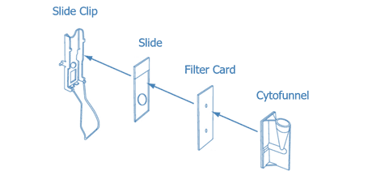
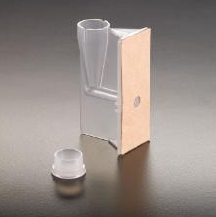
Preparation Methods: Cytocentrifugation
Cytocentrifuge places cells in a fluid directly on slides
Ideal for all specimen types except thick mucoid samples
Produces high cell recovery for low cellular samples
Initial centrifugation at 2,200 rpm for 5 mins is suggested
Pour off supernatant and examine cell button.
Use pipettes to place drops in chambers
Sample chambers hold maximum 0.5ml about 20 drops
Typically, 5-6 drops approx 0.1 ml
Filter absorbs fluid, use enough drops to avoid drying
Cells placed in monolayer in concentrated area

Slide 30
Preparation Methods: Liquid Based Preparations
Revolutionized cytology practice
FDA approved, automated devices that produce monolayer preparations
Ideal for most specimen types
Hologic ThinPrep® System and TriPath Imaging SurePath™ System
ThinPrep processors 2000 to now 5000
Separates debris and disperses mucus
Gentle vacuum collects cells on exterior surface of membrane filter
Cells deposited in monolayer on TP microscope slides

Slide 31
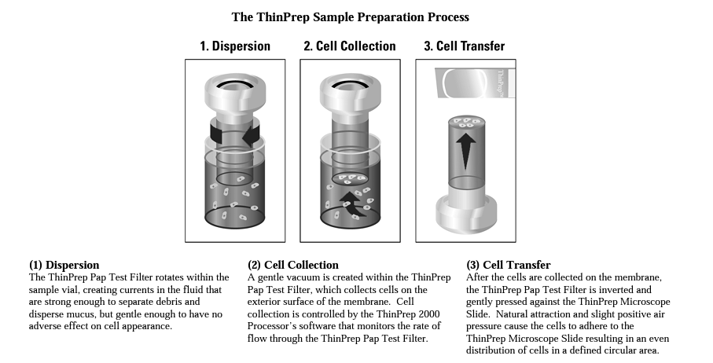
Preparation Methods: Liquid Based Preparations

Slide 32
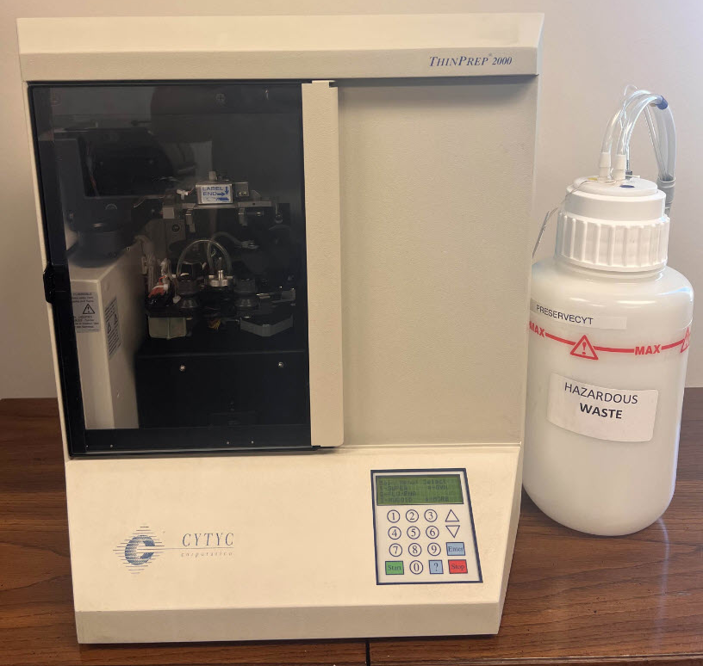
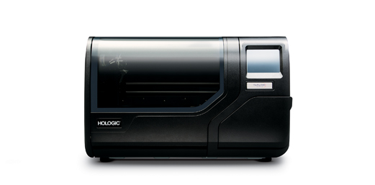
Preparation Methods: Liquid Based Preparations

Slide 33
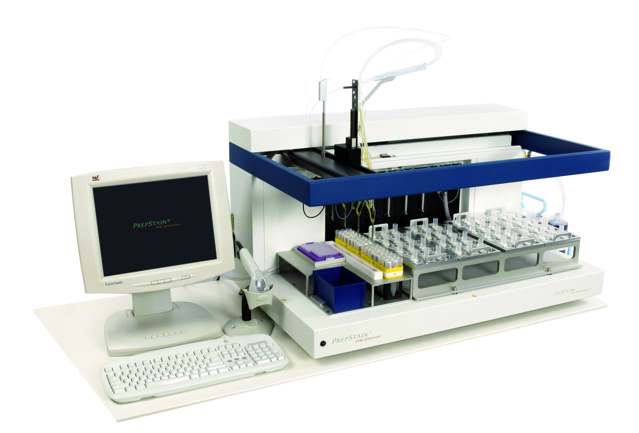
Preparation Methods: Liquid Based Preparations
TriPath Imaging™ SurePath
  Differing protocols for gyn and nongyns
  PrepStain workstation is more complex than ThinPrep
  Density gradients are used to separate cells from blood and mucus.

Slide 34
Preparation Methods: Membrane Filters
Produces high cell recovery rate
Cellulose and polycarbonate membrane filters commercially available
  Gelman and Millipore-140 um thick cellulose
  Nucleopore-transparent 10um polycarbonate
Pore diameter used is 5 um
Fresh specimen preferred, fixed clogs filter
No centrifugation needed for most samples
  Centrifuge body cavity fluids & urine regardless of volume
    Urine salts & body cavity protein debris clogs filters
    After centrifugation, resuspend button in balanced salt solution, centrifuge and then filter
Chloroform, methanol, xylene, acetone and 100% ETOH damages filters

Slide 35
Preparation Methods: Membrane Filters

Slide 36
Preparation Methods: Cell Blocks
Paraffin embedding of fluid sediments for histologic processing
Contain valuable diagnostic material and tissue fragments
Histologic patterns of disease can be recognized
Multiple sectioning allows variety of stains and ancillary techniques
Always make cell blocks if you have enough material
Variety of prep methods
Recall: 10% buffered formalin preferred fixative once block made

Slide 37
Preparation Methods: Cell Blocks
Cell Block Prep Methods:
  Fixed Sediment Method - most commonly used method. Packed sediment or fibrin clot harvested from cell button, placed in lens paper, cassette and fixed.
  Plasma Thrombin - best for cellular samples. 1 ml plasma added to button, vortexed, add 1 ml thrombin, Formed clots placed in cassette
  Colloidion bag -centrifuge cell sediment in colloidion “bag”, bag formed by colloidion coating tube, centrifuge sediment in coated tube. Place in cassette
  Hologic Cellient® -ideal for acellular samples, automated cell block maker.
  Tissue fragments from smears using mounting media and filter with cigarette paper reported.

Slide 38
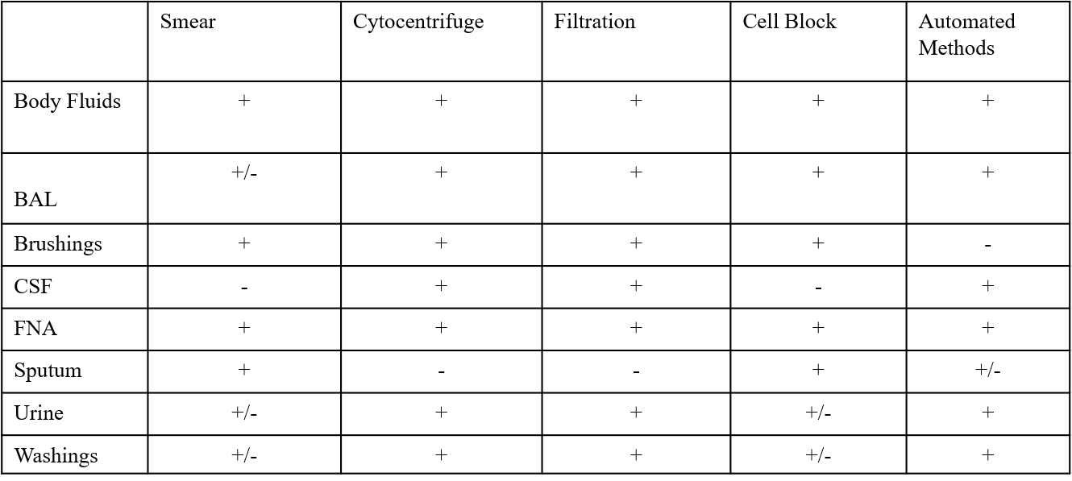
Choosing a Preparation Method

Slide 39
Preparation Methods: Special Techniques
Mucus Rich Samples: Sputum, bronchial washing, mucoid and viscous samples have poor cell yield; prefixation in 70% ETOH
  Pick and Smear Technique
    Used for sputum samples fresh or fixed with 50% ETOH
    Sputum poured into petri dish hold against dark background
    Select bloody areas, pick up pea size areas
    Place on clean slides
    Use other clean slide to crush bloody areas, distribute and fix in 95% ETOH
  Dithiothreitol (DTT) Mucus Liquefaction
    addition of 0.2% DTT in 60% ethanol and 3% carbowax.
    Fresh samples double volume DTT/volume sample, let sit or 1 hour, centrifuge.
    No need sit for fixed samples.
  Liquid Based Preparations
    Now preferred method.
    Both ThinPrep® and SurePath™ methods contain mucolytic agents

Slide 40
Preparation Methods: Pick and Smear Technique

Slide 41
Preparation Methods: Special Techniques
  Saccomanno’s Technique
    Replaced by liquid based methods
    Involves use of Saccomanno fixative and Waring blender.
    Saccomanno’s fixative commercially available. [2% polyethylene glycol solution in 50% ETOH (2ml polyglycol in approximately 1L ETOH)]
    Sputum collected in at least equal volume fixative.
    Sample blended high speed, 5 to 10 mins.
    Centrifuged, decant supernatant carefully and vortex sediment
    One or two drops for direct smears
    Alternative-Rifampin solution fixative. Same blending technique

Slide 42
Preparation Methods: Saccomanno’s Technique

Slide 43
Preparation Methods: Special Techniques
Blood Rich Samples: Blood offers valuable diagnostic information but also obscures cells.
  Refer back to slide 22 on Lysing Fixatives
Low Cellularity Samples
  urines, CSF and cyst fluids often low cellularity.
  Direct Smear not ideal, other techniques useful.
  Bale’s technique produces cell rich smears or cytospins
    Bale’s solution of 2% Carbowax in 70% ETOH, sediment from button placed in test tube with 4ul Bale’s solution. Agitate slides. Proceed to centrifugation or cytocentrifugation. Fix in 95% ETOH.

Slide 44
Preparation Methods: Special Techniques

Slide 45
Preparation Methods: Special Techniques
Clotted Material: Bloody samples not collected in anticoagulants (heparin). Press against slide of container to release fluids.

Slide 46
References
Bibbo and Wilbur (2015). Comprehensive Cytopathology, 4th Edition.
Gill (2013). Cytopreparation, Principles and Practice.
Keebler and Somack (1993). The Manual of Cytopathology, 7th edition.
Koss, L.(2006) Diagnostic Cytology and its Histologic Basis, 5th edition.
Mody, Thrall & Krishnamurthy( 2018). Diagnostic Pathology. Cytopathology, 2nd edition.

